Slide 1
Hack Your Habits!
“People do not decide their futures, they decide their habits and their habits decide their futures.” F.M. Alexander
John Kennedy
President and Primary Neuroplastician
Mental Performance Institute
john@combatbraintraining.com

Slide 2
Did you think about habits you’d like to change?
(we’ll come back to them!
Notes:
lkdqlkqlqsqslwdqwc

Slide 3
Hacking your habits is one result of
Applied Neuroplasticity
developed at the request of the US Marines in 2007.
Notes:
lkdqlkqlqsqslwdqwc

Slide 4
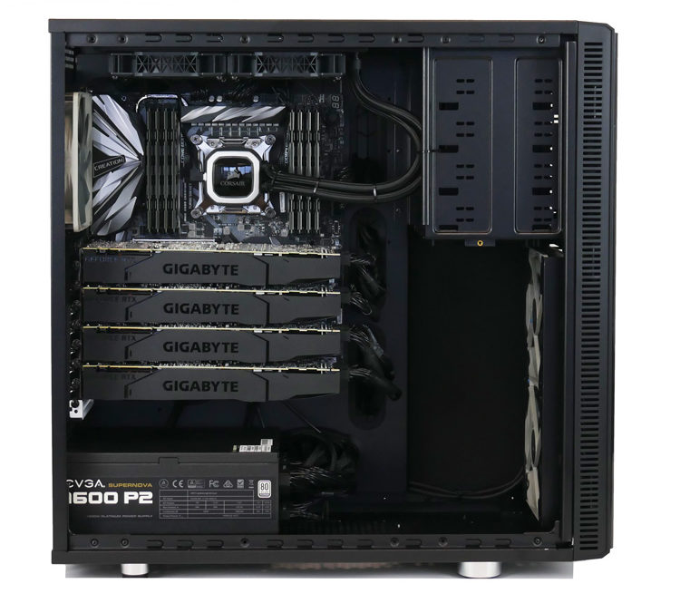
Applied Neuroplasticity
impacts:
Habitude – your habits - applications
Attitude – your mindset – operating system
Cognitude – mental agility - CPU

Slide 5
Two components of
Applied Neuroplasticity
P + N = AN
Notes:
lkdqlkqlqsqslwdqwc

Slide 6
P = Process
If you can't describe what you are doing as a process, you don't know what you are doing.” ― W. Edwards Deming

Slide 7
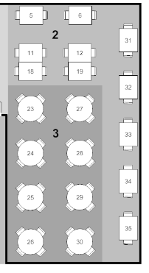
I learned the hard way, and it all started with this…

Slide 8
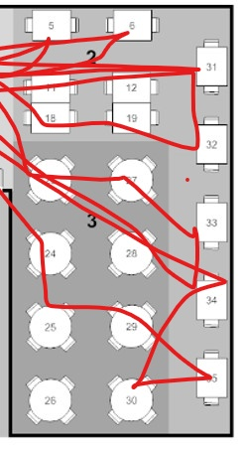
Can you relate?
There was no way I could fix this on my own, no matter how good I was at what I did.

Slide 9
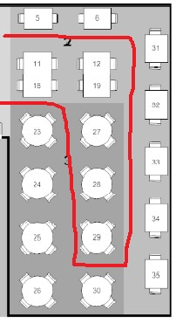
Eureka - Power of Defined Process
Became
Process not me!

Slide 10
Results:
Best service ever!
Platform for future innovations including food
One of fastest restaurants to be top rated in Chicago Magazine
Happy staff – servers sold their stations
Happy customers
Happy Owner
Happy me!
Notes:
lkdqlkqlqsqslwdqwc

Slide 11
Capability Maturity Model
Ad Hoc
Repeatable
Defined
efficient productivity
stress and burnout
herding
cats
Operational
Efficiency

Slide 12
How did operational efficiency help?
Built the first PMO at Abbott Labs, Presidents Council Award
Fastest, most effective approach

Slide 13
How did operational efficiency help?
Built the first PMO at Abbott Labs, Presidents Council Award
Led the entire Y2K transition for Motorola PCS
Fastest, most effective approach

Slide 14
How did operational efficiency help?
Built the first PMO at Abbott Labs, Presidents Council Award
Led the entire Y2K transition for Motorola PCS
Led the largest Capability Maturity Assessment at Motorola
Fastest, most effective approach

Slide 15
How did operational efficiency help?
Built the first PMO at Abbott Labs, Presidents Council Award
Led the entire Y2K transition for Motorola PCS
Led the largest Capability Maturity Assessment at Motorola
Supported C-level of International Shipping Company to streamline logistics and improve Customer Service
Fastest, most effective approach

Slide 16
How did operational efficiency help?
Built the first PMO at Abbott Labs, Presidents Council Award
Led the entire Y2K transition for Motorola PCS
Led the largest Capability Maturity Assessment at Motorola
Supported C-level of International Shipping Company to streamline logistics and improve Customer Service
Specialized in Project Rescue working directly with the CIO of Aon to close 20 high profile projects in 3 months that had languished for 2 years, including a global security assessment
Fastest, most effective approach

Slide 17
How did operational efficiency help?
Built the first PMO at Abbott Labs, Presidents Council Award
Led the entire Y2K transition for Motorola PCS
Led the largest Capability Maturity Assessment at Motorola
Supported C-level of International Shipping Company to streamline logistics and improve Customer Service
Specialized in Project Rescue working directly with the CIO of Aon to close 20 high profile projects in 3 months that had languished for 2 years, including a global security assessment
Director Midwest Project Management Center of Excellence for Sprint Paranet
Fastest, most effective approach

Slide 18
New challenge!
Imagine if your work environment wasn’t this, but …

Slide 19
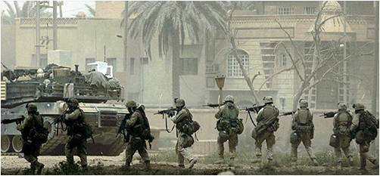
…this !

Slide 20
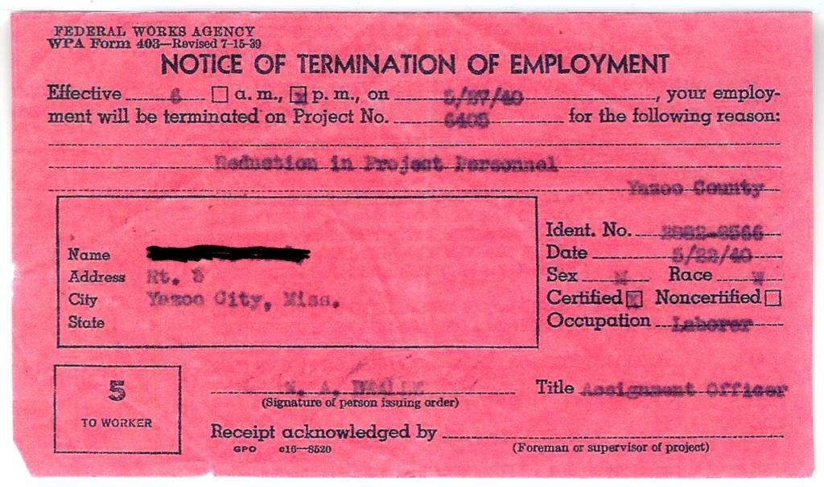
And if you made a mistake you wouldn’t get this…

Slide 21
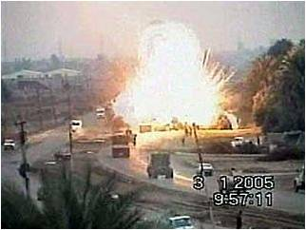
…but this!

Slide 22
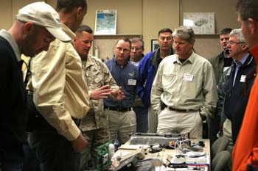
IED Industry Day,
29 Palms CA
The most dangerous threat to our men and women in combat are Improvised Explosive Devices, IED’s.
“IED’s are killing us, can you help?”
– my brother David in 2006

Slide 23
Our Guides
Why did they have better intuition?

Slide 24
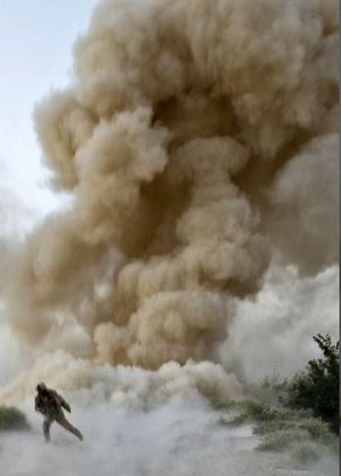
Mental Efficiency
I realized the critical factor to survival was mental efficiency – focus and faster unconscious decision making.

Slide 25
Could we apply the CMM model to improve mental efficiency?
Ad Hoc
Repeatable
Defined
Executive
Function
stress and burnout
normal
processing
Mental Efficiency
And if so … how?

Slide 26
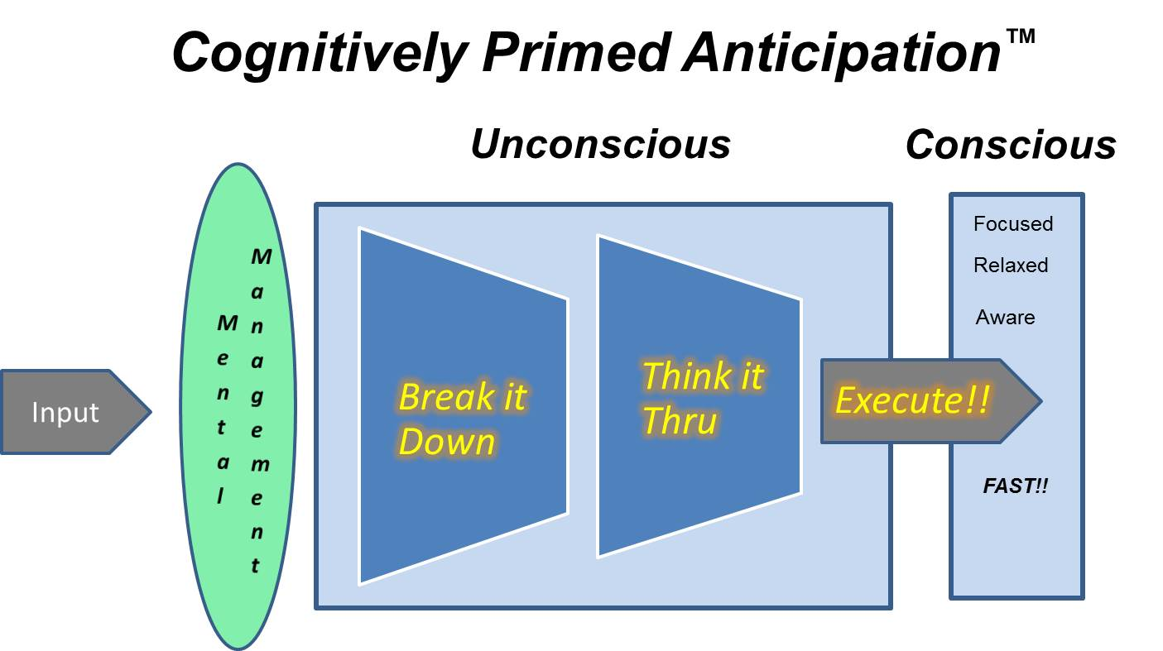
Defined Thinking Process
Focus & Attention
Break it down >
Think it thru > Execute!
Focus & Attention

Slide 27
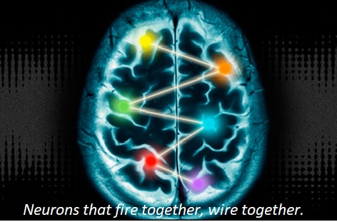
N = Neuroplasticity
“Neuroplasticity is the property of the brain that allows it to change its structure and function in response to what it senses, what it does and even what it thinks and imagines.” - Norman Doidge, The Brain That Changes Itself

Slide 28
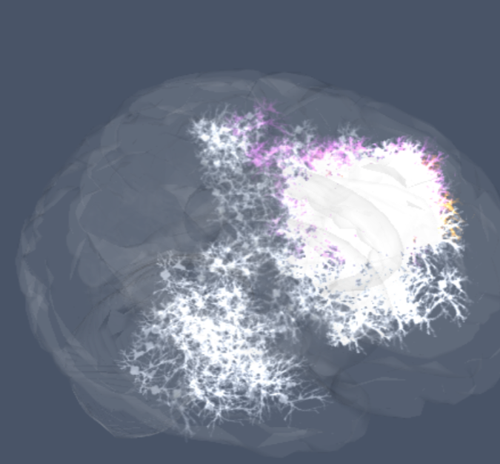
Robust Stimulation stimulating all parts of the brain/body interface
“The development of particular neurological connections or skills …tend to occur suddenly, appearing in short intervals after robust stimulation, it is as if there is a single important trigger and then a functional circuit rapidly comes online.” – Akira Yoshii, MIT brain researcher, 2007

Slide 29
Flow State! (the Zone)
“optimizes System I & System II thinking to create a full-bodied meditative state that supports optimal sensory processing; and practicing that creates an underlying neural synchronization that is easier to return to, the more you practice it.”
Sherri Livengood, Neuroscientist
Thinking as a habit!

Slide 30
Applied Neuroplasticity
Applying a Defined Process Model to the
brain using Neuroplasticity as the medium
P + N = AN
Habitude
Attitude
Cognitude

Slide 31
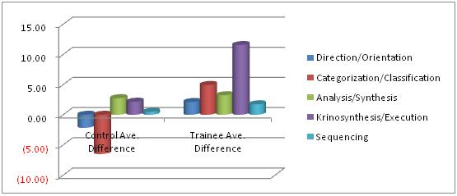
Pilot Results – Test Platoon
Before
“Worst platoon in Battalion”
Rampant PTSD
3 suicide attempts
Bottom in training results
After
“One of best ever”
No more behavioral issues
Exceeded all scoring limits
Battalion CO – “These men move better and differently than any I have seen.”

Slide 32
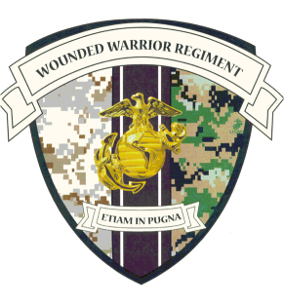
Ongoing Military Training
Due to continued evidence-based results, thousands of service member have experienced real world improvements including:
Navy SEAL’s (only program of its kind vetted and approved by US Special Operations)
Army and Air Force pilots
Navy EOD and corpsmen
Marine Corps Rifle and Pistol Teams, Recon and MarSOC
Active Duty, National Guard and Reservists

Slide 33
Thousands helped!

Slide 34
Can we apply the CMM model to improve habits?
Ad Hoc
Repeatable
Defined
Best Habits
Habits,
good and bad
Random
acts
Change Habits
And if so … how?

Slide 35
Zombie Systems
“A Zombie System is a set of sensory motor systems that can do very complicated behaviors in the absence of consciousness.”
- Francis Crick and Christof Koch
Conscious to unconscious!!

Slide 36
What is a habit?
Zombie System
Stimulus
Results
A zombie system out of control!

Slide 37
Get control!
DEFINE the habit!
Define the habit you want
Decide if you will:
Replace the bad habit, or
Insert a mini habit at the beginning
Repeat until it becomes a zombie system, conscious to unconscious

Slide 38
First, change habits by replacement Identify the habit to change, define its replacement and repeat consciously until it becomes unconscious

Slide 39
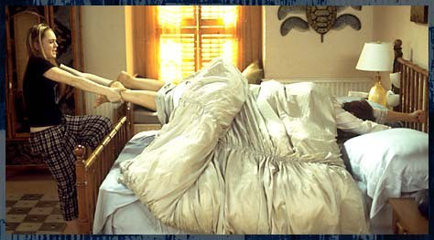
getting out of bed
Notes:
MPT as a team yields even more benefits as members understand each others efficiencies, work together to improve deficiencies, relate MPT to real world situations together. Great team building exercise.
39

Slide 40
The hit-the-snooze-button zombie system
Let's use the CMM to break this bad habit and create the one you want!

Slide 41
The 5-step Get Out of Bed Zombie System
Start by defining the exact process you want to follow when the alarm goes off – your excellent routine. Here’s a written 5-step program you can use:
Get out of bed;
Turn off the alarm;
Turn and make your bed;
Walk to your closet or the bathroom, whichever is next in your routine; and
Look back your bed and compliment yourself for a job well done.

Slide 42
Robust Stimulation is Key!
On a non deadline day, set aside 30 minutes –
Set your alarm for 2 minutes and get into bed, close your eyes, and get as relaxed as possible.
Read through and visualize the 5 steps you will perform.
As soon as the alarm goes off, run through your 5-step process – not mentally – actually do it!

Slide 43
Robust Stimulation is Key!
Get out of bed;

Slide 44
Robust Stimulation is Key!
2. Turn off the alarm;

Slide 45
Robust Stimulation is Key!
3. Turn and make your bed;
“If you want to change the world, start off by making your bed.” – Adm. McRaven

Slide 46
Robust Stimulation is Key!
4. Walk to your closet or the bathroom, whichever is next in your routine; and

Slide 47
Robust Stimulation is Key!
5. Look back at your bed and compliment yourself for a job well done!

Slide 48
Make it a Zombie System!
Get back into bed and repeat!
Get back into bed and repeat!
Get back into bed and repeat!
Get back into bed and repeat!
A new habit in 30 minutes!

Slide 49
What about something completely different?
This Habit Hack is universally applicable!

Slide 50
Universally applicable
Bad habit
“I try to remember when I’m playing but I always take my eyes off the ball when it hits my racquet.”
Defined Zombie System
Hit the ball repeatedly off of the backboard, consciously looking at the ball each time it hits the raquet.
Repeat a hundred times in a few minutes.
Success in less than 30 minutes!

Slide 51
Second, change habits by insertion Identify the habit to change, identify the trigger and insert a conscious stimulus in front.

Slide 52
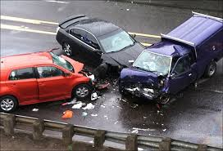
Texting while driving
Notes:
MPT as a team yields even more benefits as members understand each others efficiencies, work together to improve deficiencies, relate MPT to real world situations together. Great team building exercise.
52

Slide 53
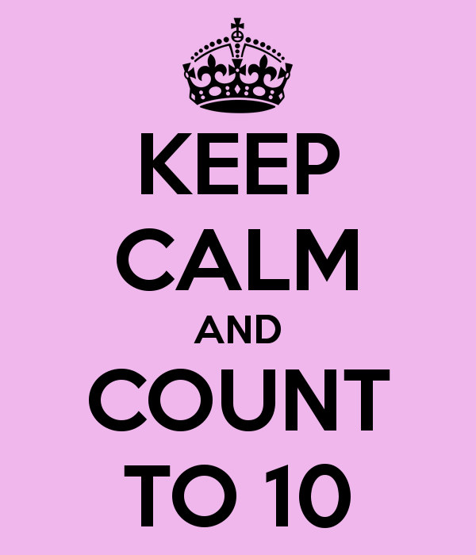
Stimulus insertion
Count to 10 when text notification sounds
Creates conscious window of choice
Easy to wait 10 seconds
May save your life!

Slide 54
Universally applicable
Bad habit
“I can’t remember to get my racquet up when my opponent is hitting the ball, even though I know it greatly improves my ability to return his shot.
Defined Zombie System
Practice saying “up” and lifting the raquet over and over, imagining your opponent about to hit the ball.
In the game, as soon as you hit the ball, say “up” and lift your raquet.
Success in less than 30 minutes!

Slide 55
Hack your habits!
Identify the habit you want to change
Determine whether replacement or insertion is best
Define what you want to achieve very specifically
Mentally walk through the steps, being aware of what you feel
Write the process down
Perform the process using as many of your senses as possible
Repeat!

Slide 56
Lets work on your habits!
Volunteers?

Slide 57
I want to help you exceed all of your performance expectations!
Send me an email with feedback, and I will send you:
This deck
A Hack your habits worksheet
Information on how you can transform your personal and work life using Applied Neuroplasticity
john@combatbraintraining.com

Slide 58
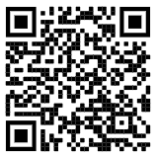
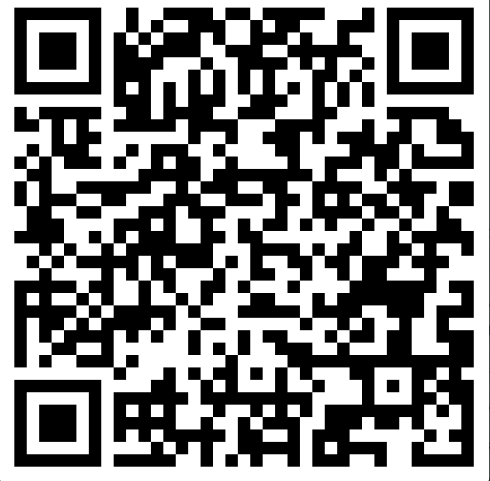
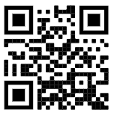
Bonus
QR Code list
A link to schedule a free 30 minute consult:
A sneak peek at this year's 5th Edition of Brilliant Breakthroughs app:
A bonus 100 Do’s and Don’ts from Amazon #1 Best Selling Business Authors

Slide 59
Quick Cognitude hacking exercise

Slide 60
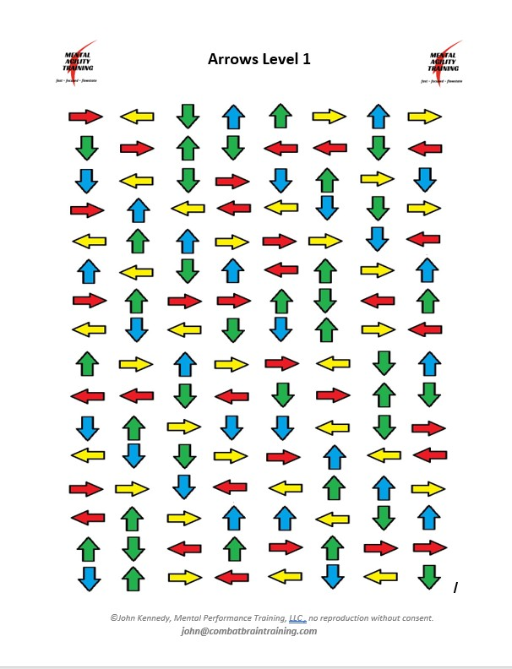
Notes:
MPT as a team yields even more benefits as members understand each others efficiencies, work together to improve deficiencies, relate MPT to real world situations together. Great team building exercise.
60

Slide 61
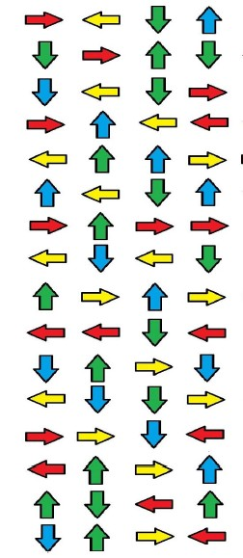
Lets make thinking a Zombie System!
Notes:
MPT as a team yields even more benefits as members understand each others efficiencies, work together to improve deficiencies, relate MPT to real world situations together. Great team building exercise.
61

Slide 62
Notes:
MPT as a team yields even more benefits as members understand each others efficiencies, work together to improve deficiencies, relate MPT to real world situations together. Great team building exercise.
62

Slide 63
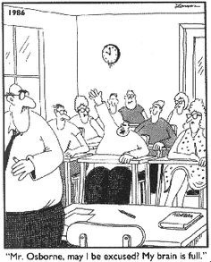
Questions?
Don’t end up like this guy!

